Slide 1
Chapter 9 Relations
9.1 Relations and Their Properties
9.2 n-ary Relations and Their Applications
9.3 Representing Relations
9.4 Closures of Relations
9.5 Equivalence Relations
9.6 Partial Orderings

Slide 2
Homework: May 6
Sec. 9.1 7(a,c,h), 26, 32, 49, 53
Sec. 9.3 13,14,31
8th
根据答案，订正作业
Homework: May 6
Sec. 9.1 7(a,c,h), 26, 32, 47, 51
Sec. 9.3 13,14,31
7th

Slide 3
Social Relationships
There are many kinds of relationships in the world:
Relative: Relationship by blood or by a common ancestor.
Friendship: boyfriend and girlfriend
Relations between Teachers and students
Relations between bosses and employees

Slide 4
Social Relationships
Relations between war and peace
Relations between city and village
Relations between God and mankind
Relations between mankind and their environment
Relations between obama and osama (bin laden)
And so on…

Slide 5
Abstract Relationships
The question is how to represent relationship in mathematical methods
N-ary relationships (complex ): relationships among many objects.
But most of the relationship can be formalized in the idea of binary relation.
Binary relation is the simplest relation, it is what we will study in this course.

Slide 6




【Definition】A binary relation R from a set A to a set B is a subset of A×B.
  Note:
  A binary relation R is a set.
  R ⊆ A×B
〖Example 1〗
(1)
(2) Let R be the set of integer numbers,

Slide 7



1. Functions As Relations
The graph of function f from set A to set B is a relation from A to B.
〖Example 2〗
Suppose that .
f: A→B, f(1)=f(3)=1,f(2)=f(4)=0
Conversely, if R is a relation from A to B, is it the graph of a function?
〖Example 3〗

Slide 8
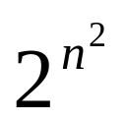
2. Relations on a Set
【Definition】A relation on the set A is a relation from A to A.
  Note:
  R ⊆ A×A
〖Example 4〗
Let
Question:
How many binary relations are there on a set A with n elements?

Slide 9
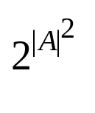
    Question: How many relations are there on a set A?
    Solution: Because a relation on A is the same thing as a subset of A ⨉ A, we count the subsets of A × A. Since A × A has n² elements when A has n elements, and a set with m elements has 2^{m} subsets, there are subsets of A × A. Therefore, there are relations on a set A.

Slide 10
3. Representing Relations
The methods of representing a relation:
    list its all ordered pairs
    using a set build notation/specification by predicates
    2D table
    Connection matrix /zero-one matrix
    Directed graph/Digraph

Slide 11

〖Example 5〗
 | 2 | 3 | 4 | 5 | 6
2 | × |  | × |  | ×
3 |  | × |  |  | ×
4 |  |  | ×

Slide 12


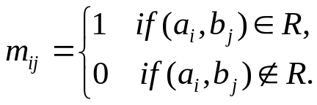
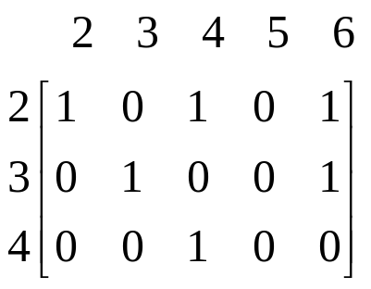
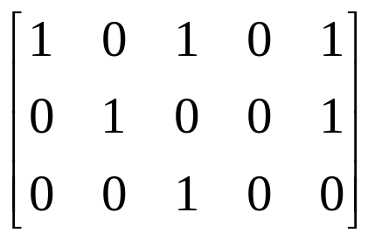
4. Connection Matrices
【Definition】Let R be a relation from
An connection matrix for R is defined by
For example,

Slide 13
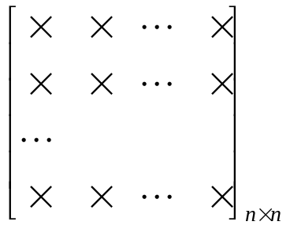
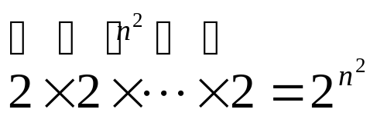
Question:
How many binary relations are there on a set A with n elements?
0,1
By the product rule,

Slide 14
5. Directed graph/Digraph
【Definition】A directed graph or a digraph, consists of a set V of vertices together with a set E of ordered pairs of elements of V called edges(or arcs).
The vertices a,b is called the initial and terminal vertices of the edge (a,b), respectively.
For example,
2
2
3
4
3
5
4
6

Slide 15
〖Example 6〗A = {0, 1, 2,3}
0
1
3
2
R = {(0,0), (0,3), (2,0),(2,1),(2,3),(3,2)}.

Slide 16
Binary Relations on a Set
Example: Consider these relations on the set of integers:
  R₁ = {(a,b) | a ≤ b}, R₄ = {(a,b) | a = b},
  R₂ = {(a,b) | a > b}, R₅ = {(a,b) | a = b + 1},
  R₃ = {(a,b) | a = b or a = −b}, R₆ = {(a,b) | a + b ≤ 3}.
  Which of these relations contain each of the pairs
  (1,1), (1, 2), (2, 1), (1, −1), and (2, 2)?
Solution: Checking the conditions that define each relation, we see that the pair (1,1) is in R₁, R₃, R₄ , and R₆: (1,2) is in R₁ and R₆: (2,1) is in R₂, R₅, and R₆: (1, −1) is in R₂, R₃, and R₆ : (2,2) is in R₁, R₃, and R₄.
Note that these relations are on an infinite set and each of these relations is an infinite set.

Slide 17
6. Special Properties of Binary Relations
    Reflexive （自反）
    Irreflexive
    Symmetric
    Antisymmetric
    Transitive

Slide 18
6. Special Properties of Binary Relations
    Reflexive
    Irreflexive
    Symmetric
    Antisymmetric
    Transitive

Slide 19

【Definition】A relation R on a set A is reflexive if
Example: The following relations on the integers are reflexive:
  R₁ = {(a,b) | a ≤ b},
  R₃ = {(a,b) | a = b or a = −b},
  R₄ = {(a,b) | a = b}.
  The following relations are not reflexive:
  R₂ = {(a,b) | a > b} (note that 3 ≯ 3),
  R₅ = {(a,b) | a = b + 1} (note that 3 ≠3 + 1),
  R₆ = {(a,b) | a + b ≤ 3} (note that 4 + 4 ≰ 3).
If A = ∅ then the empty relation is reflexive vacuously. That is the empty relation on an empty set is reflexive!

Slide 20

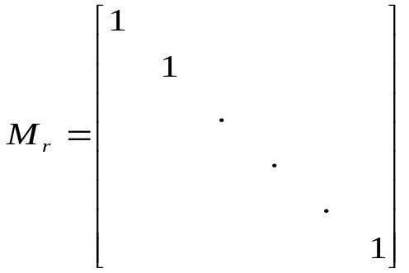
  Questions:
  (1) What do we know about matrices representing reflexive relations?
All the elements on the main diagonal of must
be 1s.
  (2) What do we know about digraphs representing reflexive relations?
  There is a loop at every vertex of the directed graph.

Slide 21
6. Special Properties of Binary Relations
    Reflexive
    Irreflexive
    Symmetric
    Antisymmetric
    Transitive

Slide 22

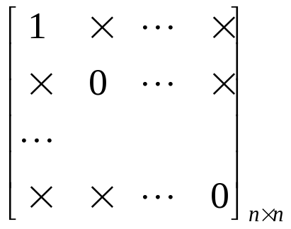
【Definition】A relation R on a set A is irreflexive if
  Questions:
  The connection matrix of an irreflexive relations?
  Digraph?
  Can a relation on a set be neither reflexive nor irreflexive?
  Yes.

Slide 23
6. Special Properties of Binary Relations
    Reflexive
    Irreflexive
    Symmetric
    Antisymmetric
    Transitive

Slide 24

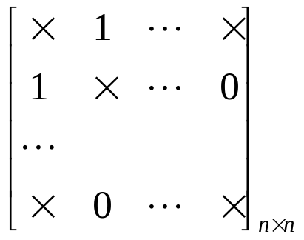
【Definition】A relation R on a set A is symmetric if
  Questions:
  The connection matrix of a symmetric relations?
  Digraph?
  If there is an arc (x, y) there must be an arc (y, x).

Slide 25
Symmetric Relations
Example: The following relations on the integers are symmetric:
  R₃ = {(a,b) | a = b or a = −b},
  R₄ = {(a,b) | a = b},
  R₆ = {(a,b) | a + b ≤ 3}.
  The following are not symmetric:
  R₁ = {(a,b) | a ≤ b} (note that 3 ≤ 4, but 4 ≰ 3),
  R₂ = {(a,b) | a > b} (note that 4 > 3, but 3 ≯ 4),
  R₅ = {(a,b) | a = b + 1} (note that 4 = 3 + 1, but 3 ≠4 + 1).

Slide 26
6. Special Properties of Binary Relations
    Reflexive
    Irreflexive
    Symmetric
    Antisymmetric
    Transitive

Slide 27
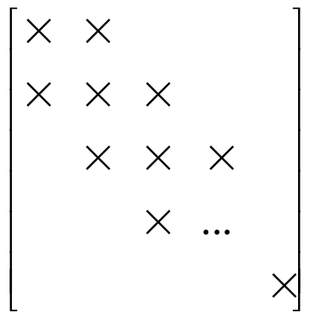
【Definition】A relation R on a set A is antisymmetric if
  Note:
  (1)
  (2)
1
0
0
0,1

Slide 28
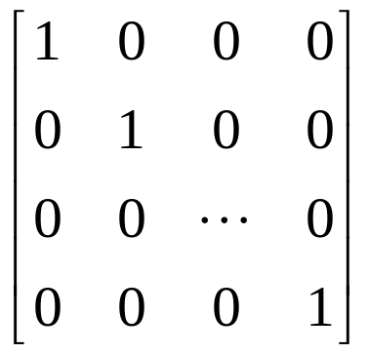
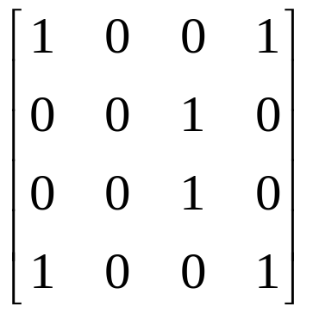
  (3) If there is an arc from x to y there cannot be one from y to x if x≠ y.
  (4) The symmetric and antisymmetric relations are not opposites.
  For example,

Slide 29
Antisymmetric Relations
Example: The following relations on the integers are antisymmetric:
  R₁ = {(a,b) | a ≤ b},
  R₂ = {(a,b) | a > b},
  R₄ = {(a,b) | a = b},
  R₅ = {(a,b) | a = b + 1}.
  The following relations are not antisymmetric:
  R₃ = {(a,b) | a = b or a = −b}
  (note that both (1,−1) and (−1,1) belong to R₃),
  R₆ = {(a,b) | a + b ≤ 3}
  (note that both (1,2) and (2,1) belong to R₆).

Slide 30
6. Special Properties of Binary Relations
    Reflexive
    Irreflexive
    Symmetric
    Antisymmetric
    Transitive

Slide 31
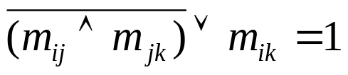
【Definition】A relation R on a set A is transitive if whenever
  Note:
  (1)
  Why?
  (2) If there is an arc from x to y and one from y to z then there must be one from x to z.
Notes:
if relation conversion to logic

Slide 32
Transitive Relations
Example: The following relations on the integers are transitive:
  R₁ = {(a,b) | a ≤ b},
  R₂ = {(a,b) | a > b},
  R₃ = {(a,b) | a = b or a = −b},
  R₄ = {(a,b) | a = b}.
  The following are not transitive:
  R₅ = {(a,b) | a = b + 1} (note that both (3,2) and (4,3) belong to R₅, but not (3,3)),
  R₆ = {(a,b) | a + b ≤ 3} (note that both (2,1) and (1,2) belong to R₆, but not (2,2)).
For every integer, a ≤ b
and b ≤ c, then a≤ c.

Slide 33
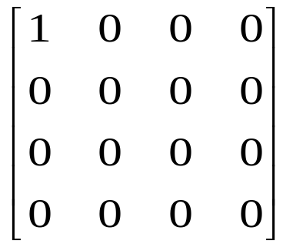
〖Example 7〗Determine whether the following relations are reflexive, irreflexive, symmetric, antisymmetric and/or transitive.
  (1)
reflexive, symmetric, antisymmetric, transitive
a
  (2)
b
d
c
not reflexive, symmetric, antisymmetric, transitive

Slide 34

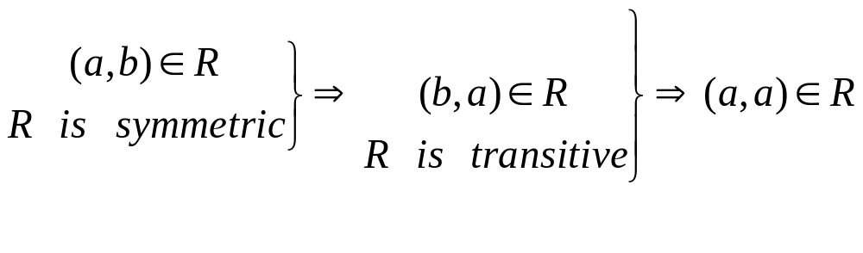

  (3)
reflexive, antisymmetric, transitive
  (4)
reflexive, symmetric, transitive
  Question: （非空！）
  Symmetric, transitive ⇒ reflexive ?
This argument makes an assumption that
Therefore, symmetry and transitivity are not enough to infer reflexivity

Slide 35
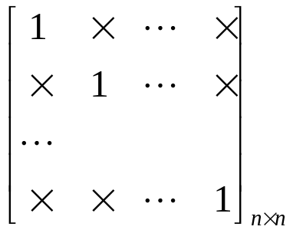
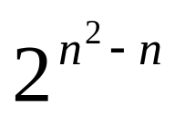
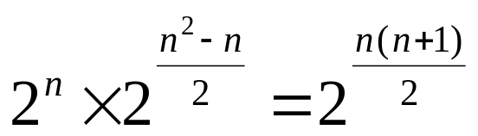
〖Example 8〗How many relations are there on a set with n
elements that are
(1) reflexive ?
  (2) symmetric ?
  (3) antisymmetric ?
Solution:
(1)
0,1
(2)

Slide 36
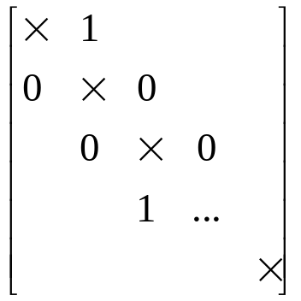
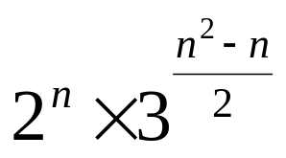
Solution:
(3)
Questions:
  reflexive and symmetric?
  transitive?

Slide 37
7. Combining Relations
Since relations from A to B are subsets of A×B, two relations from A to B can be combined in any way two sets can be combined.
    Set operation
    Composition
    Inverse relation (逆关系)

Slide 38
Combining Relations
Given two relations R₁ and R₂, we can combine them using basic set operations to form new relations such as R₁ ∪ R₂, R₁ ∩ R₂, R₁ − R₂, and R₂ − R₁.
Example: Let A = {1,2,3} and B = {1,2,3,4}.
The relations R₁ = {(1,1),(2,2),(3,3)} and
R₂ = {(1,1),(1,2),(1,3),(1,4)} can be combined using basic set operations to form new relations:
R₁ ∪ R₂ ={(1,1),(1,2),(1,3),(1,4),(2,2),(3,3)}
R₁ − R₂ ={(2,2),(3,3)}
R₂ − R₁ ={(1,2),(1,3),(1,4)}
R₁ ∩ R₂ ={(1,1)}

Slide 39
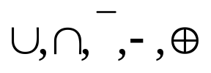




1)
〖Example 9〗 Let is the set of integers,
what are the relations ?
Solution:
(1) Set operations
Boolean operations/logical operations
The Boolean Or
The Boolean And
The Complement

Slide 40




The logical operations of matrices：
Let , the set
operations of two relations are defined by

Slide 41

2) Composition
The composite of R and S:
Question:
How to compute SoR?
    (1) Using the definition directly
    (2) Using the connection matrix

Slide 42




〖Example 10〗
Solution:
(1) Using the definition directly
Note:

Slide 43

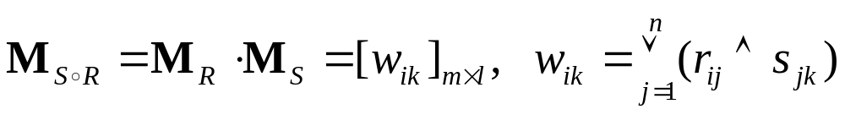
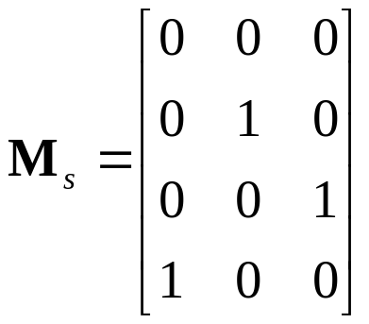
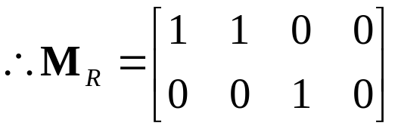
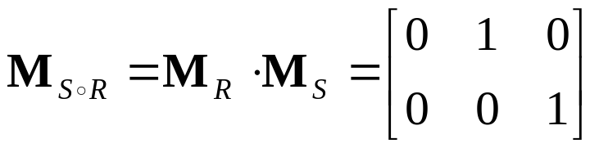

Solution:
(2) Using the connection matrix

Slide 44


【Definition】Let R be a relation on the set A. The powers
,are defined recursively by

Slide 45
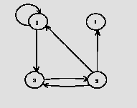
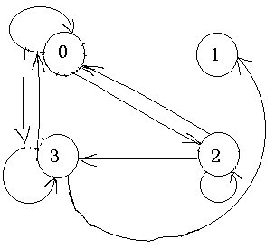
〖Example 11〗Let A={0,1,2,3}. R is the relation on the set A.
R ={(0,0),(0,3),(2,3),(3,2),(2,1),(2,0)}. R²=?
Solution:
  Using the definition
    R²={(0,0),(0,3),(0,2),(2,2),(3,3),(2,3),(2,0),(3,1),(3,0)}
  Using the digraph

Slide 46

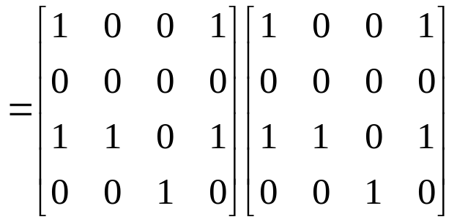
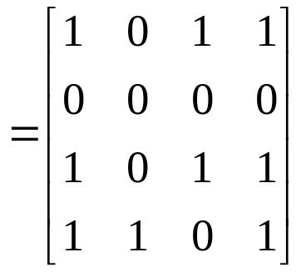
Using the matrix

Slide 47










【 Theorem 】 The relation R on a set A is transitive if and
only if
Proof:
(1)
⇒ R is transitive
(2) R is transitive ⇒
Inductive base
Inductive step
R is transitive

Slide 48





〖Example 12〗 Let R be a symmetric relation on the set A.
Show that R^{n} is symmetric for all positive integers n.
Proof:
Inductive base
n=1, R be a symmetric
Inductive step
R^{n} is symmetric ⇒ R^{n+1} is symmetric

Slide 49

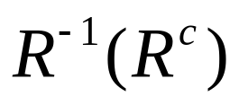




3) Inverse relation (逆关系)
The inverse relation from B to A:
Question:
How to get ?
  Using the definition directly
  For example,
(2) Reverse all the arcs in the digraph representation of R
(3) Take the transpose M_{R} ^{T} of the connection matrix M_{R} of R.

Slide 50






4) The properties of relation operations
Suppose that R, S are the relations from A to B, T is the relation from B to C, P is the relation from C to D, then
(1)
Proof:

Slide 51







4) The properties of relation operations
Suppose that R, S are the relations from A to B, T is the relation from B to C, P is the relation from C to D, then
(1)
Proof:
(2)
(3)
(4)
(5)

Slide 52




4) The properties of relation operations
Suppose that R, S are the relations from A to B, T is the relation from B to C, P is the relation from C to D, then
(1)
(2)
(3)
(4)
(5)
(6)
(7)
(8)
(9)

Slide 53
Homework: May 6
Sec. 9.1 7(a,c,h), 26, 32, 49, 53
Sec. 9.3 13,14,31
8th
Homework: May 6
Sec. 9.1 7(a,c,h), 26, 32, 47, 51
Sec. 9.3 13,14,31
7th

